Slide 1

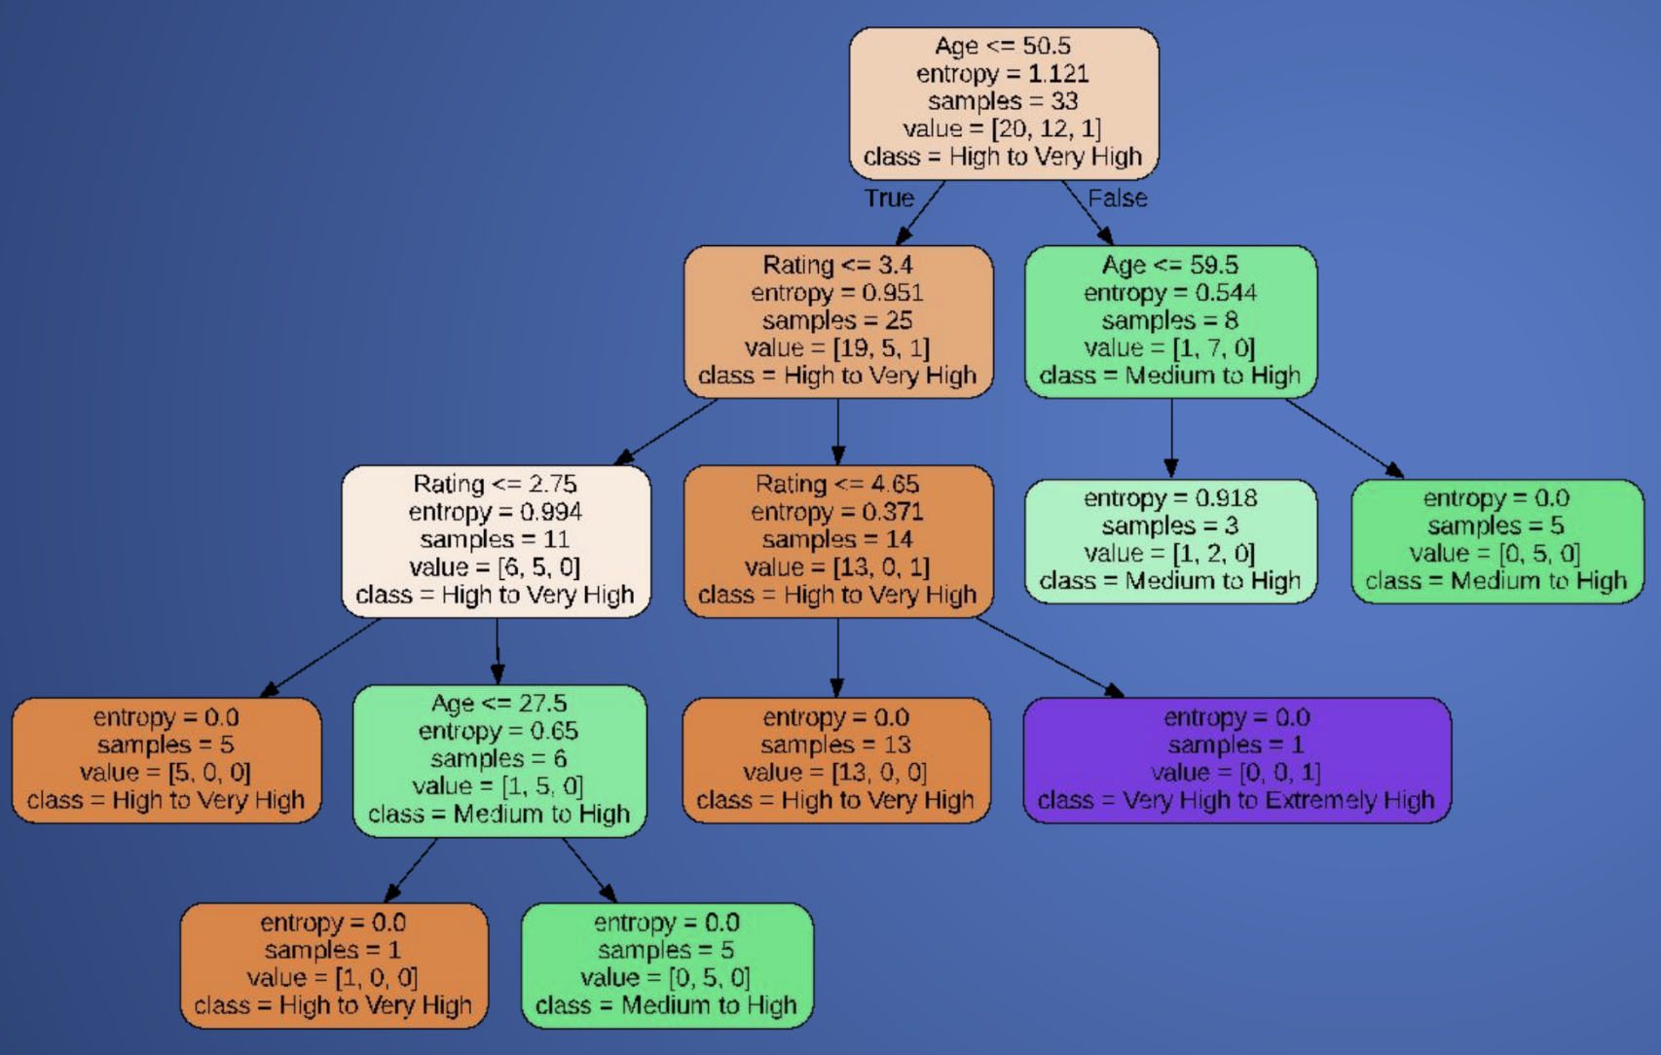
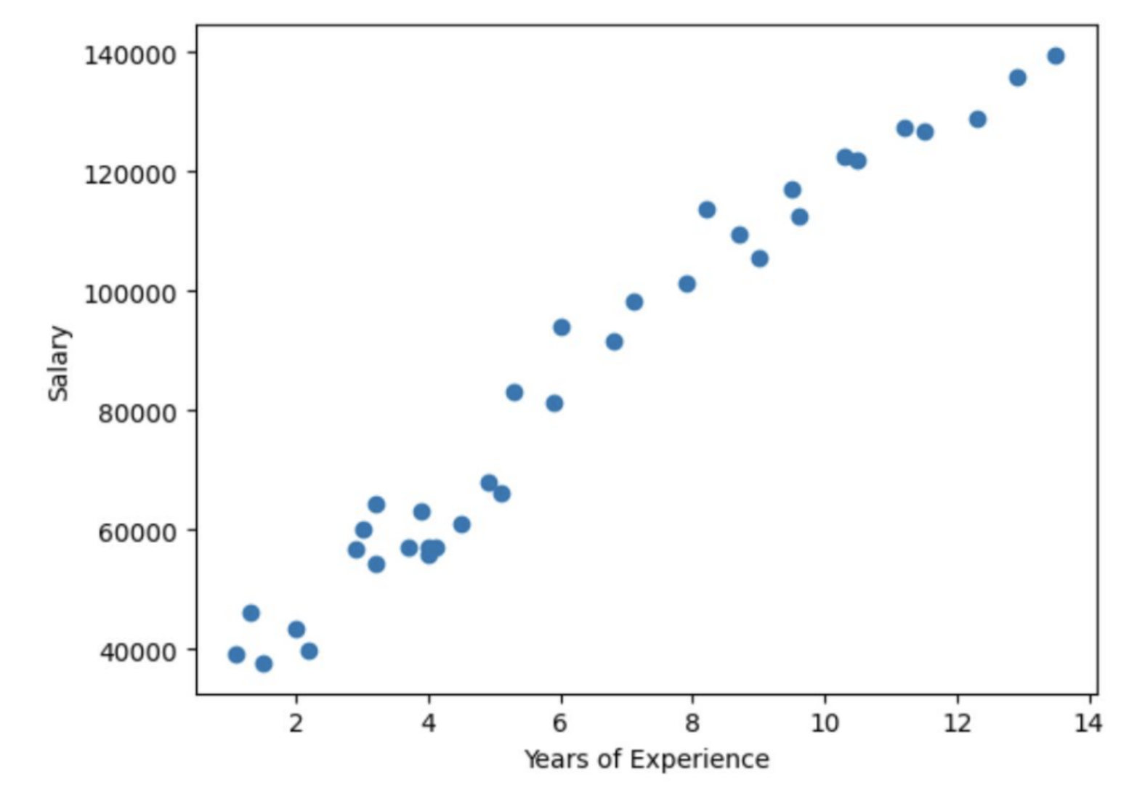
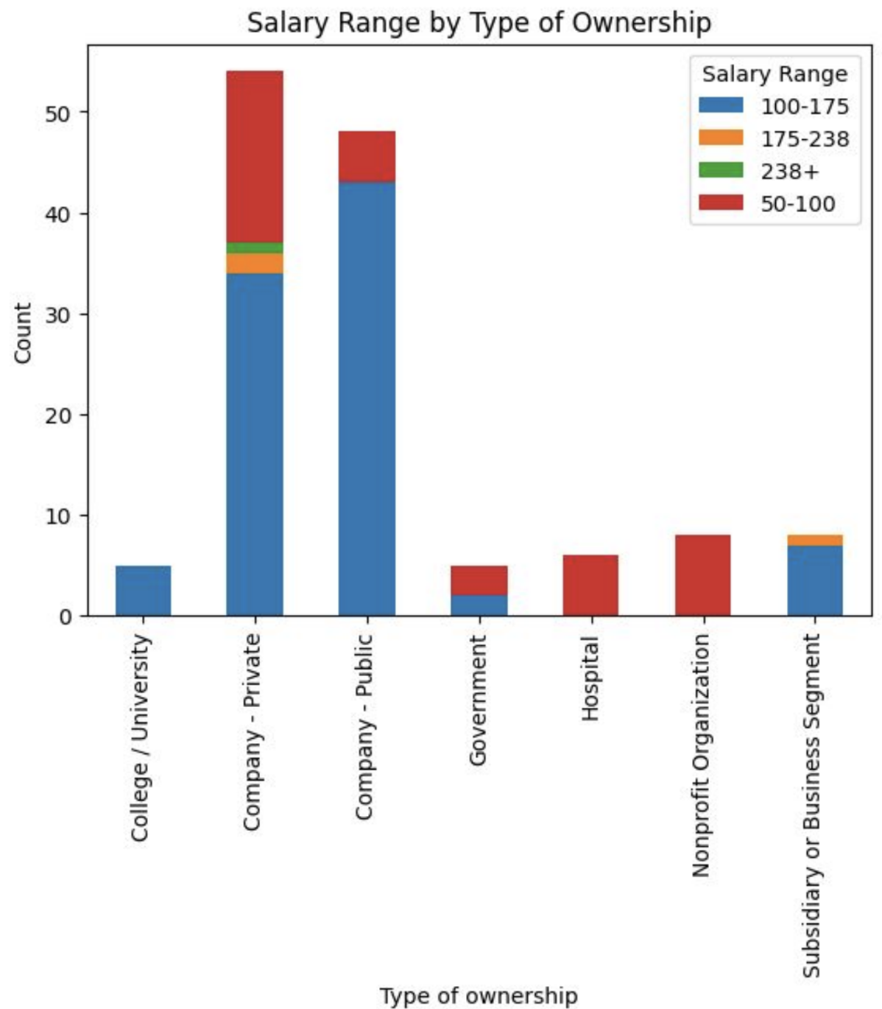
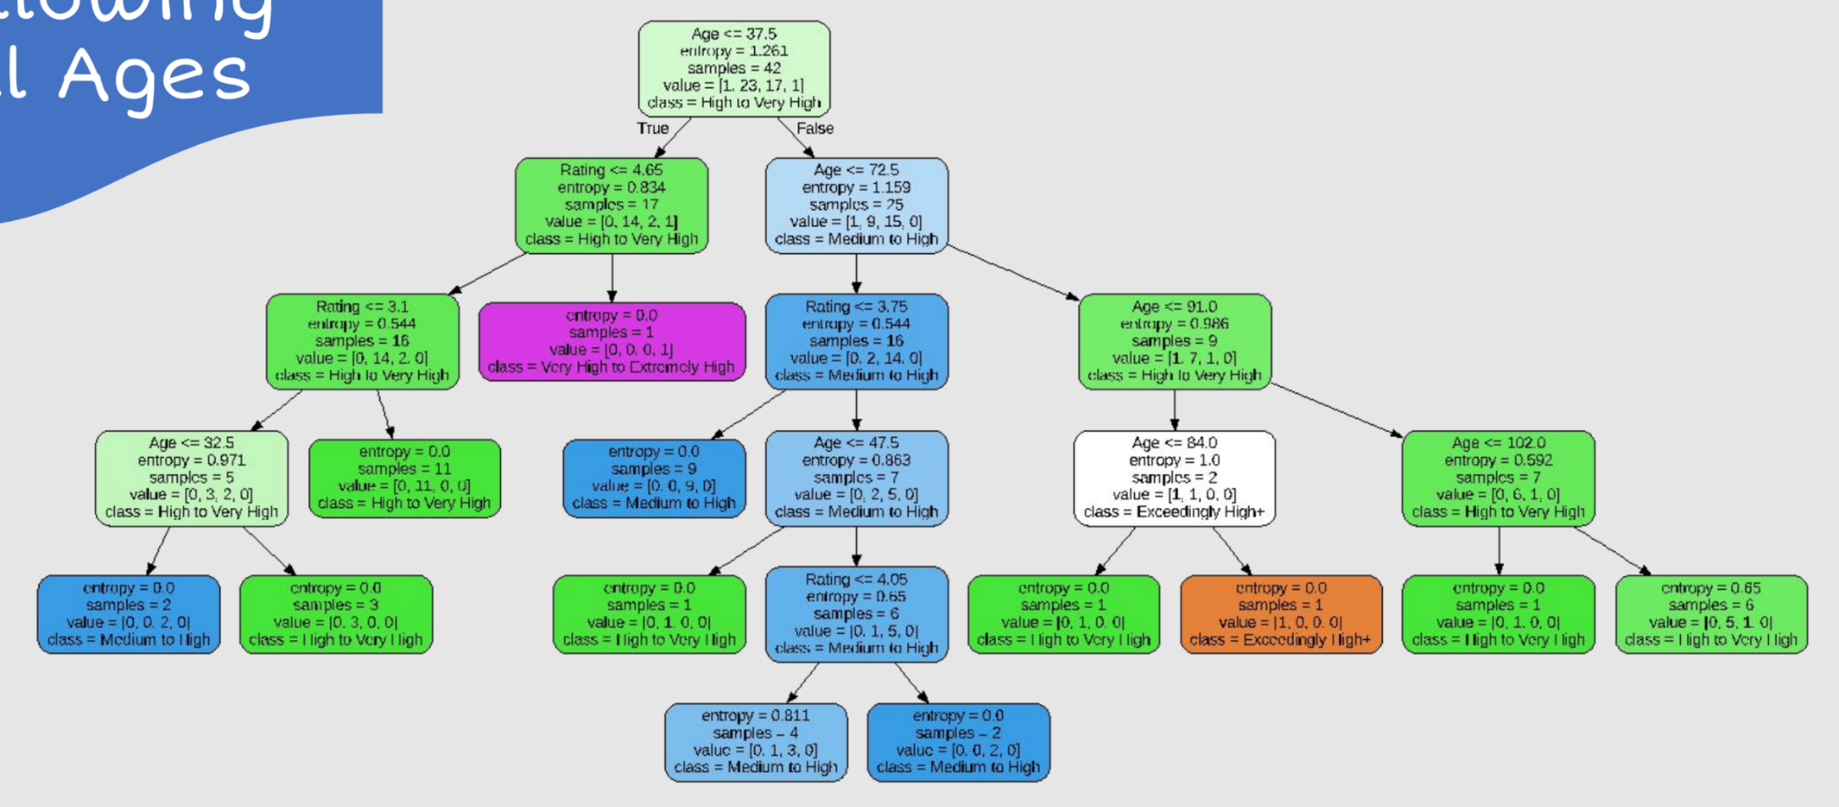
Bias & Variance Analysis in Employee Salaries
Highlights
Understanding Artificial Intelligence, in this context Salary, can help individuals maximize statistics to gain the highest Salary of a job.
It’s very important considering balance between complexity, interpretability, and fairness.
By Cleaning up our data, we may have potentially added bias. Still, with Rating and Age affecting our dataset, as well as analyzing relationships between the degree and salary.
Author 1, Author 2, Author 3
Background
The term "artificial intelligence bias" describes the way human stereotypes or presumptions can be observed in algorithms.
When an algorithm consistently produces misrepresentative data due to inaccurate presumptions made during the machine learning process, it can become a huge problem.
At first our proposed algorithm was based on detecting fraudulent data and locating nefarious attacks, creating bias in datasets and showing vulnerabilities in our Machine Model.
Model
We chose to look at linear relationships for our simple dataset, but still used Decision Trees and Linear Regression to understand the relationship of our data, allowing for up to 3 variables to be interpolated and have values found for them.
We are going to use an entropy-based algorithm that creates a decision tree. This Decision Tree is highly Complicated and long, and gives us limited information.
Analysis
Public and Private Sector has most jobs in this dataset. Further, the highest paying jobs can be found in the private sector and the business.
Despite this, most of the lower-paying jobs are found in the Private Sector.
Hospitals in this dataset are generally in the low to medium range. This doesn’t reflect doctors entirely as they are paid very well.
Ages: 18-67 Model
What Does This Have to Do With Bias?
High Bias: The Bias in our first, simpler dataset was GRAND. It basically stated that no matter what, if you have more Years of Experience, that meant you will always be paid more.
Low Variance: Regression Model was very simple, and captured what was needed. Still, with other datasets it could be too simple.
High Variance: Decision Trees are very complex for this model to give any new useful information. The correlation was obvious for the simple dataset and did not need entropy or other Machine Learning Models.
Data
The new dataset “data_cleaned_2021.csv” provides us way more information, but also has null values we must clean.
We are interested to find the easiest to work with, so Rating, Age, Salary, Seniority Status, Type of Company, etc.
Accuracy is around 75%, which isn’t the best, but with a longer dataset it would be more accurate.
As Age increases and the Rating of the company increases (Years of Experience & Rating go up).
All Ages Model
Next Steps
Improve the model by adding more variables and balancing out bias with variance to prevent overfitting and underfitting.
Using different datasets can represent new and interesting relationships in data!

